Slide 1

Cheshire and Warrington
Local Growth Fund Update
Kerry Billington
Programme Manager
Cheshire and Warrington Local Enterprise Partnership

Slide 2
Cheshire and Warrington LGF Update
Growth Deal
  £142.7m announced in July 2014
    To create up to 9,000 jobs, allow up to 500 homes to be built, and generate up to £50m public and private investment
  Further £15.2m awarded in January 2015 as part of an ‘LGF Round 2’;
  To create up to:
    9,000 jobs,
    allow up to 500 homes to be built,
    and generate up to £50m public and private investment

Slide 3
Cheshire and Warrington LGF Update
2015/16 Confirmed Funding Allocation
Paid in 2 tranches, £14.02 in 15/16 and £30.52 in 16/17
Project | LGF Allocation
Northgate Chester Central | £13.5m
Birchwood transport Improvements | £2.14m
Life Science Fund | £10.0m
Thornton Energy Demonstrator | £6.8m
Skills Capital | £12.1m
Total | £44.54m

Slide 4
Cheshire and Warrington LGF Update
2016/17 Confirmed Funding Allocation
Funding also included for some LTB schemes, a DfT Tail Major project and an increase to the Housing Revenue Account borrowing limit for Cheshire West & Warrington Council to support development of new affordable homes
* Financial responsibility retained by Department for Transport for these two schemes
Project | LGF Allocation
Warrington West, Omega M62 Junction 8 | £5.0m
Warrington Waterfront Centre Park Link Bridge | £5.3m
Poynton Relief Road* | £16.4m
Congleton Link Road* | £45.0m
Total | £71.7m

Slide 5
Cheshire and Warrington LGF Update
LGF Round 2
LGF Round 2 Confirmed Funding Allocation
Project | LGF Allocation
Crewe Green Roundabout | £3.3m
Sydney Road Bridge | £3.5m
Ellesmere Port Central Development Zone | £8.4m
Total | £15.2m

Slide 6
Cheshire and Warrington LGF Update
2015/16 Progress
Contractor start on site in September 2015
Birchwood Transport Improvements
Contractor start on site July 2015
Completion of transport improvements at Moss Gate, Oakwood Gate and Faraday Bus Gate in March 2016
Life Science Fund
Fund Manager procured – Catapult Ventures
£31m fund at launch with contributions from both private and public partners
Thornton Energy Demonstrator
Skills Capital
Site cleared and Ship Victory pub demolished and sub structure progressing well
Asbestos removal and strip out works to the building complete
Four projects approved for funding at Reaseheath College
Seed and early stage venture capital fund targeting life science businesses
Procurement of main contractor for refurbishment well underway
Including National Centre for Advanced Engineering and Agritech, Sports Science and Performance Academy, Learning Hub and Accommodation Block, and an Employer focussed Hub
Northgate Chester Central
Detailed design complete for public realm improvements for Frodsham Street/George Street

Slide 7
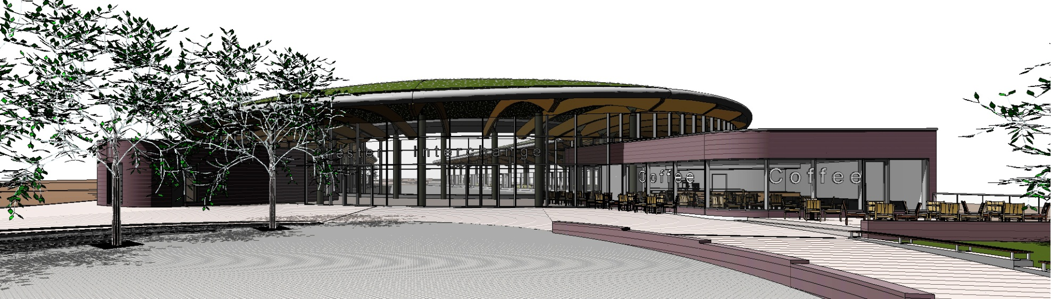
Cheshire and Warrington LGF Update
Northgate Chester Central
The relocation of the Bus Interchange to a new site at Gorse Stacks to link the bus interchange with Chester’s retail area and enhance the accessibility of pedestrian routes will allow the development of Northgate to facilitate an extensive mixed use development to reinstate the City as a major regional attraction
Creating over 48,000 sqm floorspace, 900 jobs and 40 new homes

Slide 8
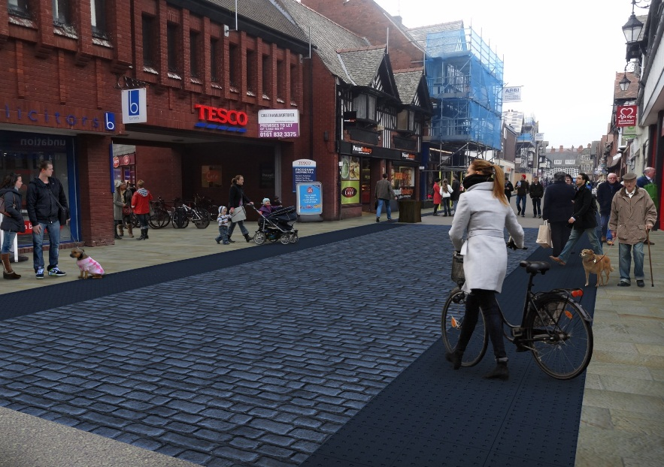
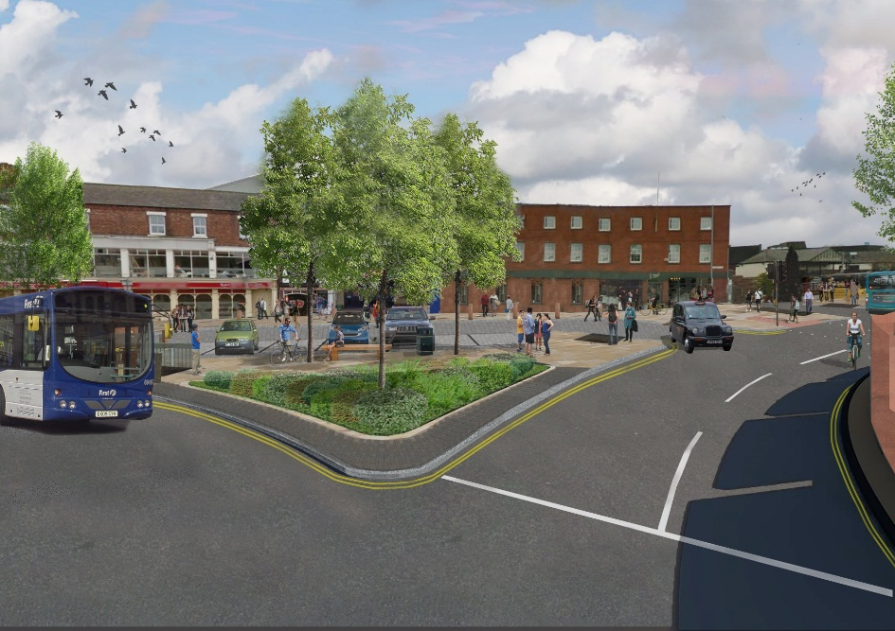
Cheshire and Warrington LGF Update
Northgate Chester Central
Brookdale Place
Public realm improvements at Frodsham street

Slide 9
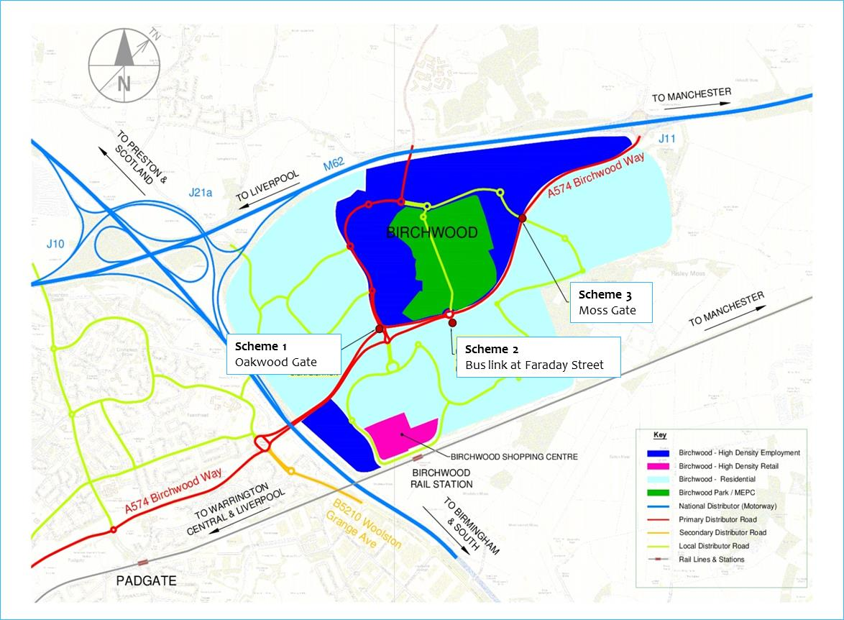
Cheshire and Warrington LGF Update
Birchwood Transport Improvements
Transport improvements to three critical locations, to relieve congestion and improve access to enable use of sites and land in the Birchwood employment area and create over 3,000 jobs

Slide 10
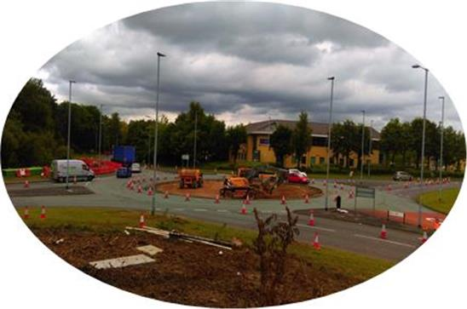
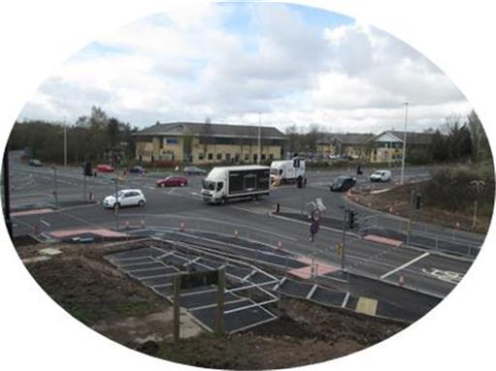
Cheshire and Warrington LGF Update
Birchwood Transport Improvements
The replacement of Moss Gate roundabout with a higher capacity junction to eliminate traffic congestion, accessibility and road safety problems

Slide 11
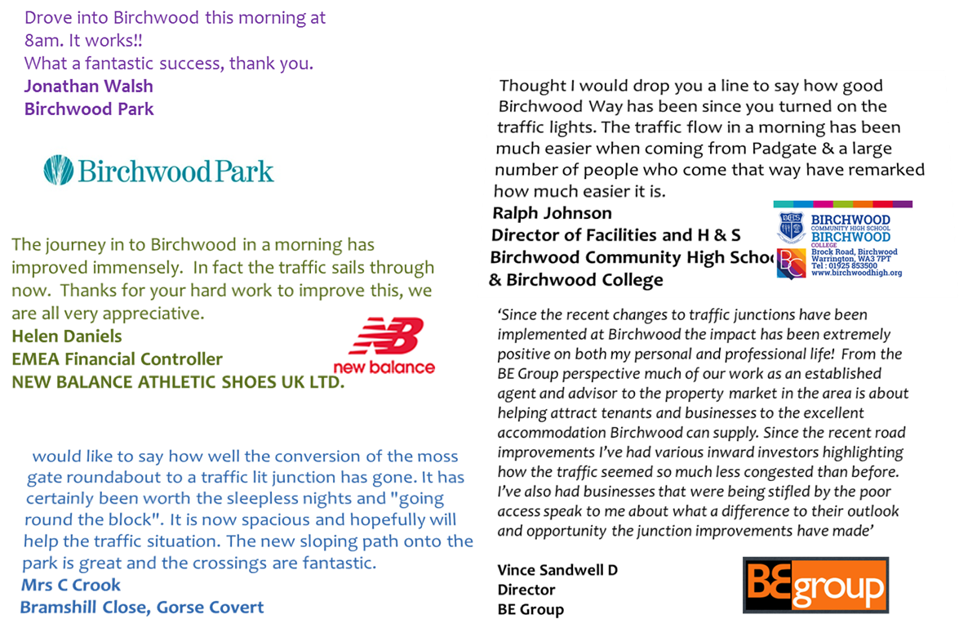
Cheshire and Warrington LGF Update
Birchwood Transport Improvements – success with stakeholders

Slide 12
Cheshire and Warrington LGF Update
Thornton Energy Demonstrator
Establishment of an energy systems demonstrator site
A reconfigurable space where industry and academia come together to experiment, innovate and commercialise
Large scale testing and modelling facility to reduce costs for industry

Slide 13
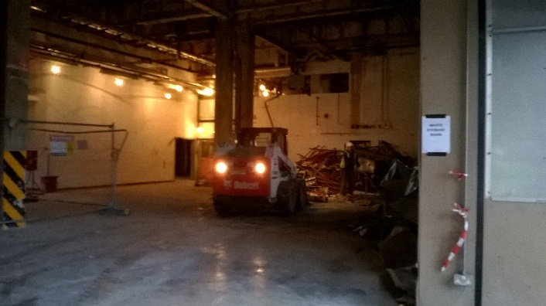
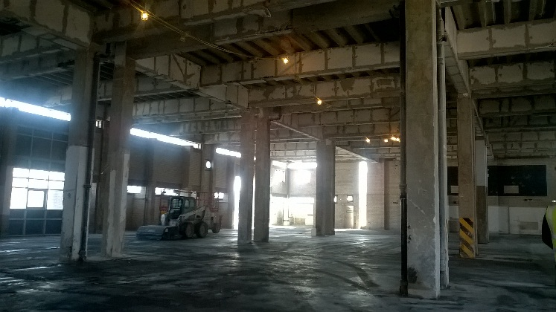
Cheshire and Warrington LGF Update
Thornton Energy Demonstrator
Pre Strip Out COMPLETED
Site and Structural Surveys COMPLETED
Execution of Design MARCH 2016
Construction on Site MAY 2016
Completion of Construction MARCH 2017
Completion of fit out May 2017
Opening/Launch JUNE 2017

Slide 14
Cheshire and Warrington LGF Update
Skills Capital – Reaseheath College
Construction of sport pitches well underway
Renovation of learning labs is nearing completion

Slide 15
Cheshire and Warrington LGF Update
Skills Capital – Reaseheath College
Four project approved and underway
Learners benefitting from the projects
  95 - Level 1 and 2
  184 - Levels 3 and 4+
  188 - Apprenticeships (16 to 18)
  81 – Adult (19+) Apprenticeships
  172 – Adult Skills Workplace
  720 in total
Over 10,000sqm floorspace created/refurbished

Slide 16
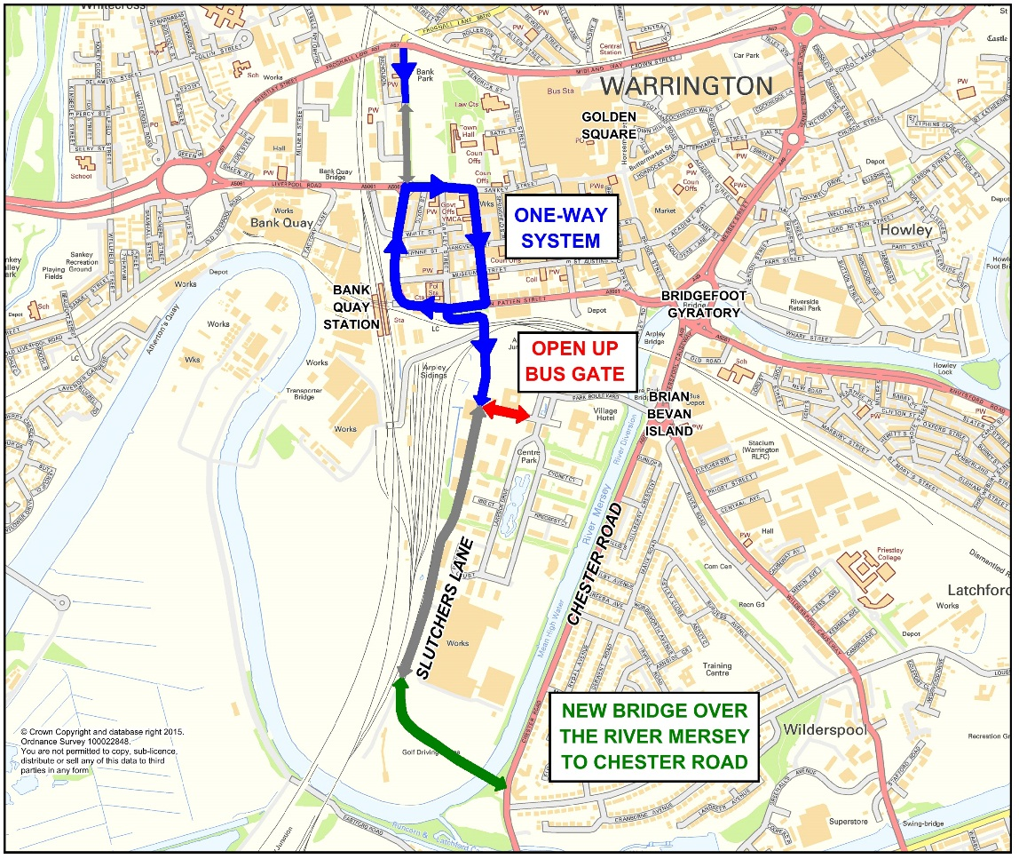
Cheshire and Warrington LGF Update
Warrington West Centre Park Link Bridge
Supports release of employment and residential site which are currently hampered by lack of access through a new bridge crossing over the River Mersey and improved route from there to Slutchers Lane

Slide 17
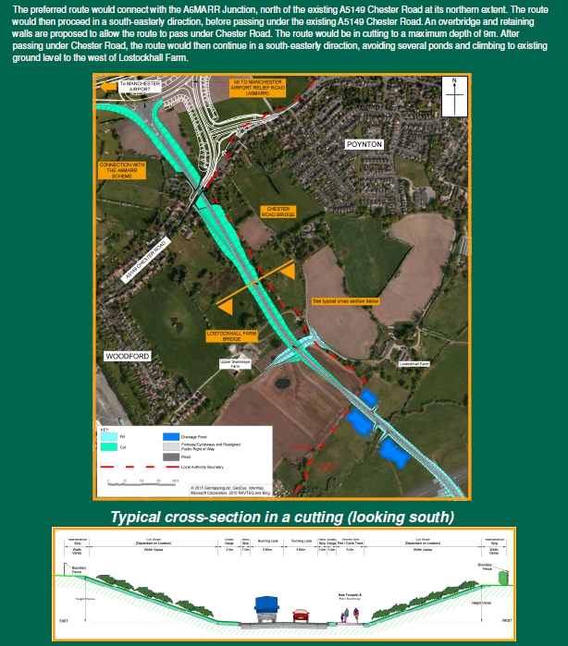
Cheshire and Warrington LGF Update
Poynton Relief Road
A proposed 3km relief road, reducing traffic congestion in Poynton which will contribute to the physical and social regeneration of Poynton. It also improves connectivity for the northern Macclesfield business area and the strategic link between A6 to Manchester Airport Relief Road and Junction 17 of the M6 via Congleton, facilitating wider economic and transport benefits

Slide 18
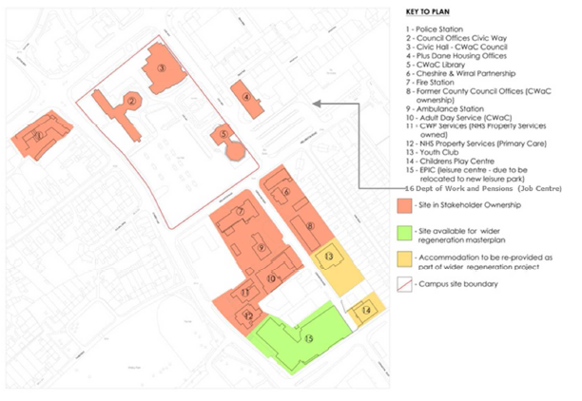
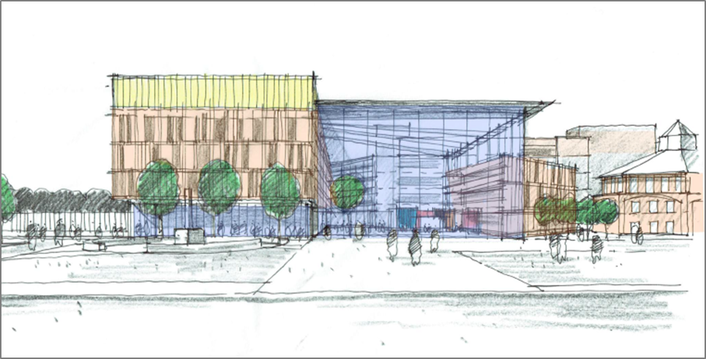
Cheshire and Warrington LGF Update
Ellesmere Port Central Development Zone
To reduce the cost of the public estate
To provide improvements in service delivery through service redesign
To act as a catalyst for regeneration and private sector investment in the town centre and wider area

Slide 19
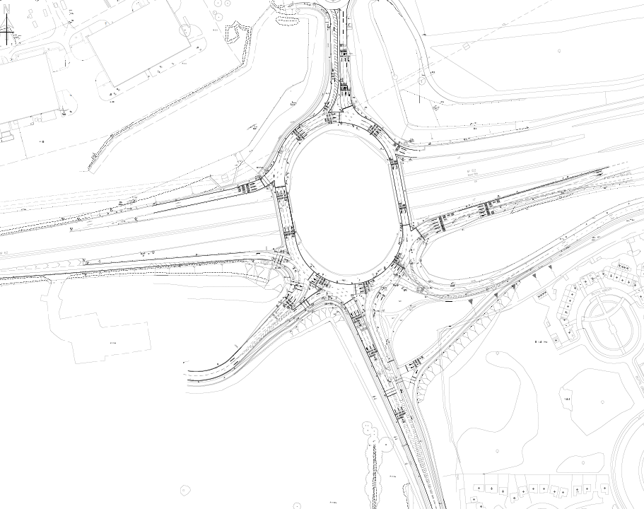
Cheshire and Warrington LGF Update
Warrington West, Omega M62 Junction 8
Widening Burtonwood Rd (N)
Widened M62 Off slip
Local widening and lining amendments across junction
Re-aligned Charon Way
Outbound
Widening on Skyline Drive

Slide 20
Cheshire and Warrington LGF Update
Key Risks and Issues
Ensuring Projects proceed on schedule and draw down grant funding in alignment with the LEP’s annual funding profile
Projects due to start in 2016/17 all require business case submissions and approvals before they can proceed
Ensuring the projects achieve their forecast outputs and outcomes
Increases to costs, funding gaps and programme issues including CPO’s

Slide 21
Kerry Billington
Programme Manager
Cheshire & Warrington Local Enterprise Partnership
kerry.billington@871candwep.co.uk
www.871candwep.co.uk/

