Slide 1
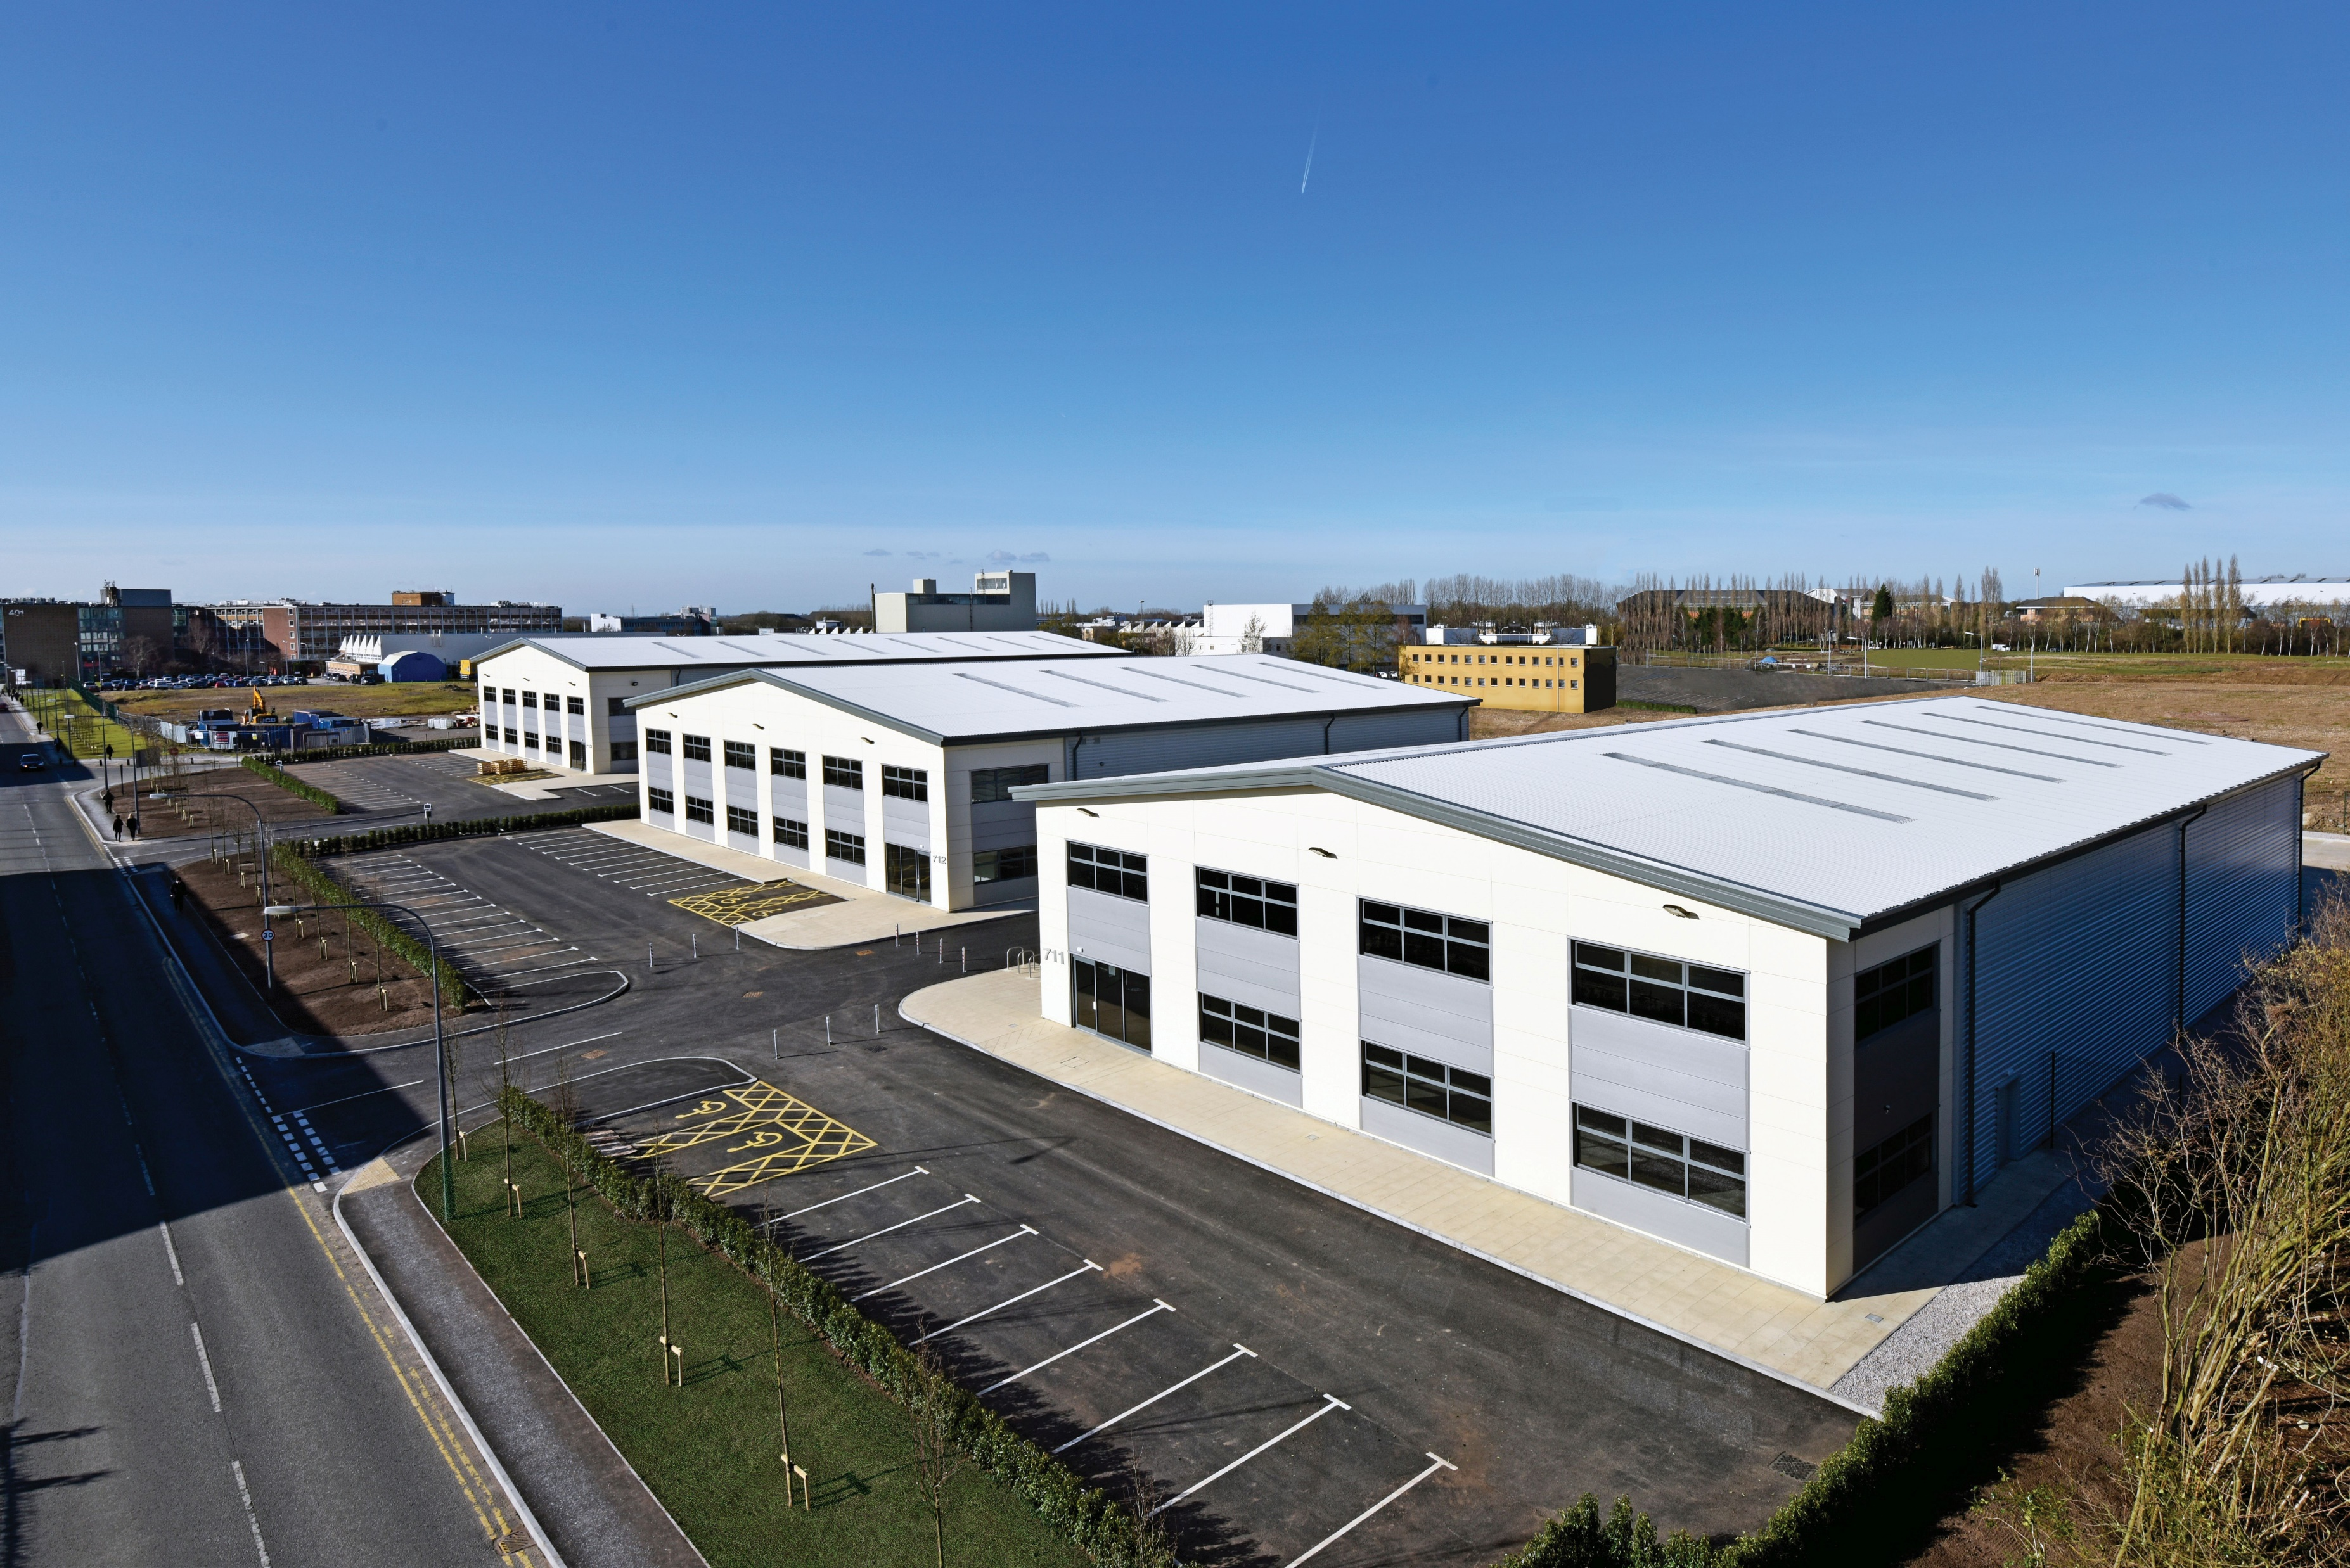
QUADRANT PHASE 2
BIRCHWOOD PARK
Performance & Investment Committee
20 March 2019

Slide 2
QUADRANT PHASE 2
Phase 1 - 3x units, let within 6 months PC
5 industrial units
15,773 sq m (169,785 sq ft) new industrial floorspace
Maximum of £3.6m EZ investment
£446k per annum retained business rates
£9.1m over lifetime of EZ
8.3 years payback

Slide 3
INVESTMENT PROPOSAL
£650k - Access Road
Up to maximum of £1m for electricity infrastructure
Maximum of 3 years void and interest cover

Slide 4
THE INVESTMENT
Element | Best Case Scenario (£) | Assumed Business Case Minus Electricity Infrastructure (£) | Assumed Business Case (£) | Worst Case Scenario (£)
Access Road | 650,000 | 650,000 | 650,000 | 650,000
Void Cover | - | 281,000 | 281,000 | 843,000
Interest Cover | - | 375,000 | 375,000 | 1,125,000
Electrical Infrastructure | - | - | 1,000,000 | 1,000,000
Total | 650,000 | 1,306,000 | 2,306,000 | 3,618,000
Payback Period (years) | 1.5 | 2.9 | 5.3 | 8.3

Slide 5
BENEFITS
Benefit | Quantum
New commercial floorspace (sq ft) | 169,785
Brownfield land reclaimed (ha) | 5.62
Number of new businesses | 5
Number of jobs (gross) | 480
Number of jobs (net) | 223
Number of construction jobs | 100
Gross Value Added (£) | 7.0m
Annual Retained Business Rates (£) | 436,000
Total Retained Business Rates (£) | 9.1m
Public/Private Sector Leverage (£) | 13.9m

Slide 6
KEY RISKS
Uncertainty about level of investment required
Business rate income
Delivery
Occupation
Rate mitigation
State Aid
Public procurement regulations

Slide 7
KEY COMMERCIAL TERMS
Approved use 10 years
No landlord rate mitigation
Longstop start date – 12 months
Practical completion within 3 years
Funder sign off on scheme costs
Overage agreement

Slide 8
FUNDING
£30m Local authority borrowing facility
Legal agreement will not signed until borrowing facility is in place

